Slide 1


Objectives
In this session, you will learn to:
New elements in HTML 5
Syntax of CSS

Slide 2
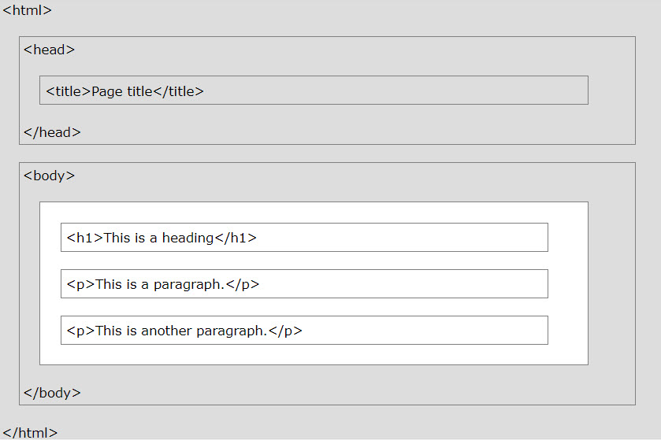
Structure of HTML page
Visualization of an HTML page structure:

Slide 3
New elements in HTML5
HTML 5 added the following form elements:
<datalist>
<output>
Browsers do not display unknown elements.
New elements that are not supported in older browsers will not "destroy" your web page.
Datalist element
Specifies a list of pre-defined options for an <input> element.
Users will see a drop-down list of the pre-defined options as they input data.
The list attribute of the <input> element, must refer to the id attribute of the <datalist> element.

Slide 4
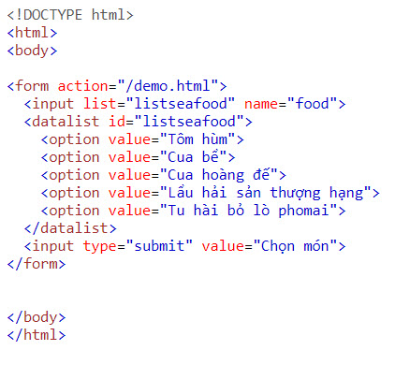
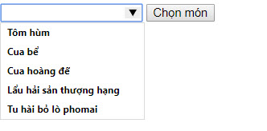
Datalist element
Example:
Result:

Slide 5
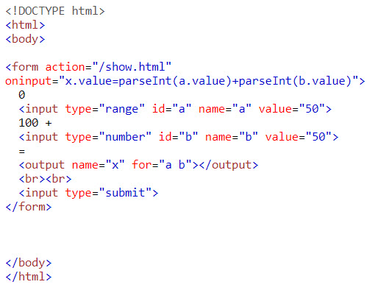

Output element
<output> element
Represents the result of a calculation (like one performed by a script)
Example:
Result:

Slide 6
HTML5 Input Types
HTML 5 added several new input types:
Color
Date
Datetime-local
Email
Month
Number
Range
Search
Tel
Time
url
week

Slide 7
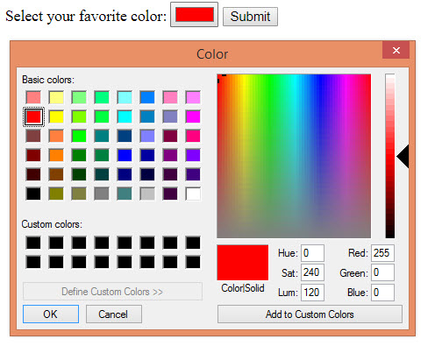
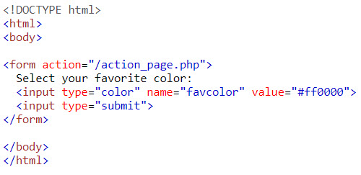
Input Type Color
Input Type Color
Is used for input fields that should contain a color
Example:
Result:

Slide 8
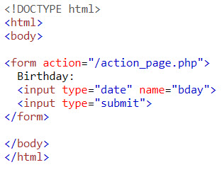
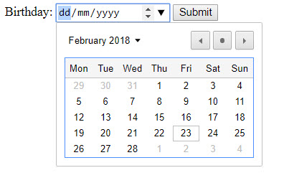
Input Type Date
Input Type Date
Is used for input fields that should contain a date.
Example:
Result:

Slide 9
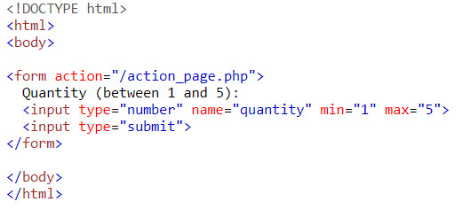

Input Type Number
Input Type Number
Defines a numeric input field.
You can also set restrictions on what numbers are accepted.
Example:
Result:

Slide 10
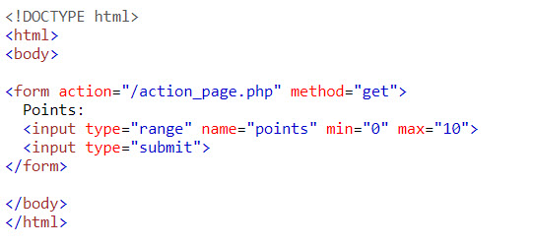

Input Type Range
Input Type Range
Defines a control for entering a number whose exact value is not important (like a slider control).
Default range is 0 to 100. However, you can set restrictions on what numbers are accepted with the min, max, and step attributes
Example:
Result:

Slide 11
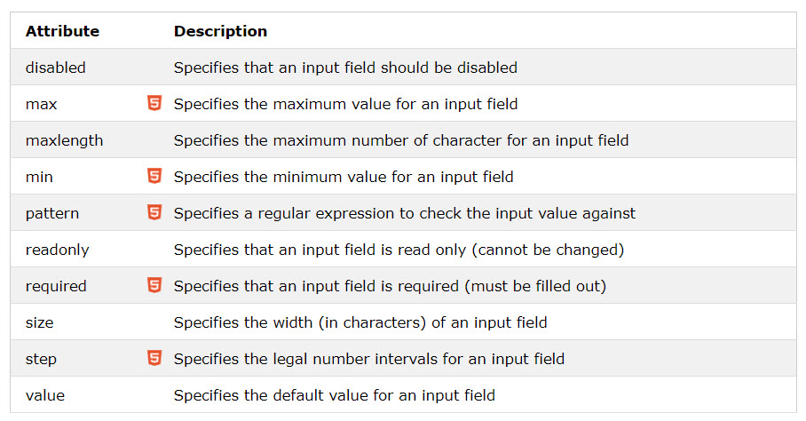
Input restrictions
List of some common input restrictions (some are new in HTML 5)

Slide 12
Validation HTML 5 form
Teacher demo validation HTML5 form by using input restrictions associate with input types

Slide 13

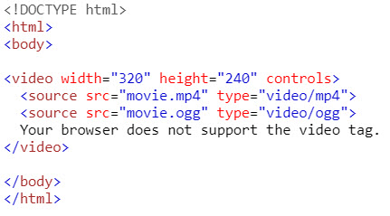
HTML5 Video/Audio
Before HTML5, a video could only be played in a browser with a plug-in (like flash).
The HTML5 <video> element specifies a standard way to embed a video in a web page.
To show a video in HTML, use the <video> element
To play an audio file in HTML, use the <audio> element
The controls attribute adds video controls, like play, pause, and volume.
It is a good idea to always include width and height attributes.
The <source> element allows you to specify alternative video/audio files which the browser may choose from. The browser will use the first recognized format.
Example:
Result:

Slide 14
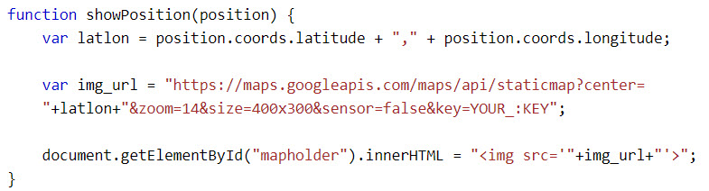
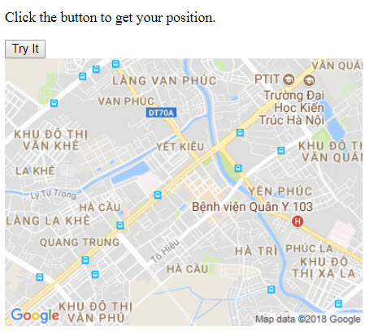
HTML5 Geolocation
The HTML Geolocation API is used to locate a user's position.
The getCurrentPosition() method is used to return the user's position.
To display the result in a map, you need access to a map service, like Google Maps.
Example:
Result:

Slide 15
CSS
Cascading Style Sheet (CSS):
Is a collection of styles used to change the appearance of HTML elements on Web pages.
Defines a set of standard rules that provide better control over the page layout and appearance.
Is used to enforce consistent display standards across all the Web pages of the website.

Slide 16
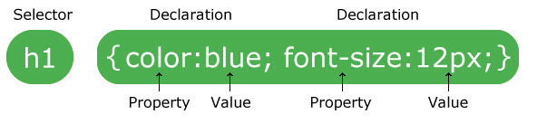
Identifying the Syntax of CSS
CSS allows the creation of one or more rules for defining the style characteristics of HTML elements.
Each CSS rule consists of the following parts:
Selector
Declaration Block

Slide 17
Identifying the Syntax of CSS (Contd.)
You can use the following syntax to define a CSS rule:
selector
{
//Declaration Block
property: value;
}

Slide 18
Identifying the Types of Style Sheets
CSS styles can be broadly classified into the following types:
CSS styles
Inline style
Internal style sheet
External style sheet

Slide 19
Identifying CSS Selectors
The user-defined CSS selectors can be classified into the following categories:
ID Selector
The id selector uses the id attribute of an HTML element to select a specific element.
The id of an element should be unique within a page, so the id selector is used to select one unique element!
To select an element with a specific id, write a hash (#) character, followed by the id of the element.
Class Selector
The class selector selects elements with a specific class attribute.
To select elements with a specific class, write a period (.) character, followed by the name of the class.
Type Selector
Selects elements based on the element name
Universal Selector
Define base style for all elements of web page

Slide 20
Identifying CSS Selectors
Teacher demo declaring CSS in HTML page
Demo CSS types: Inline, internal, external
Demo CSS Selector: ID, class, type, universal

Slide 21
Summary
New elements in HTML 5
Syntax of CSS

